Slide 2
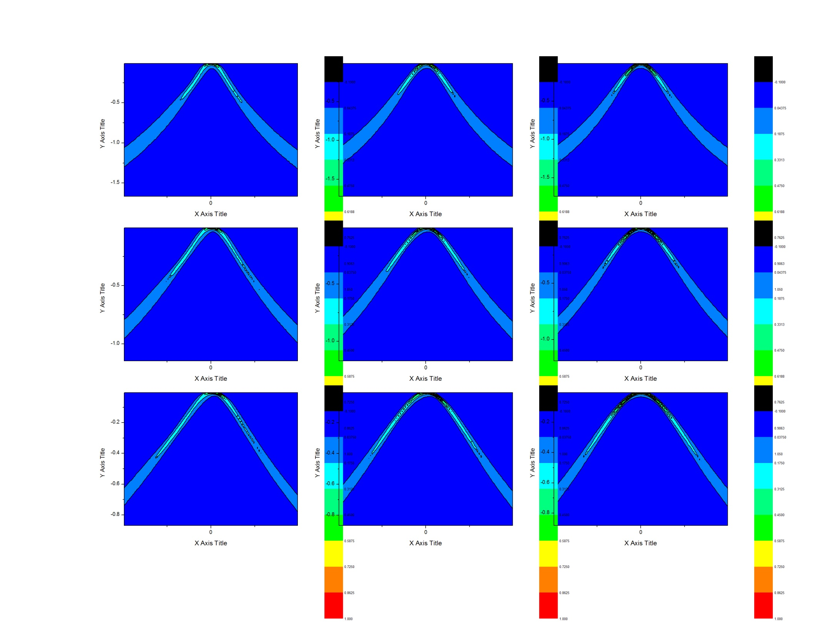
deps-3
eta0.3
eta0.4
eta0.5
gam0.5
gam0.75
gam1.0

Slide 3
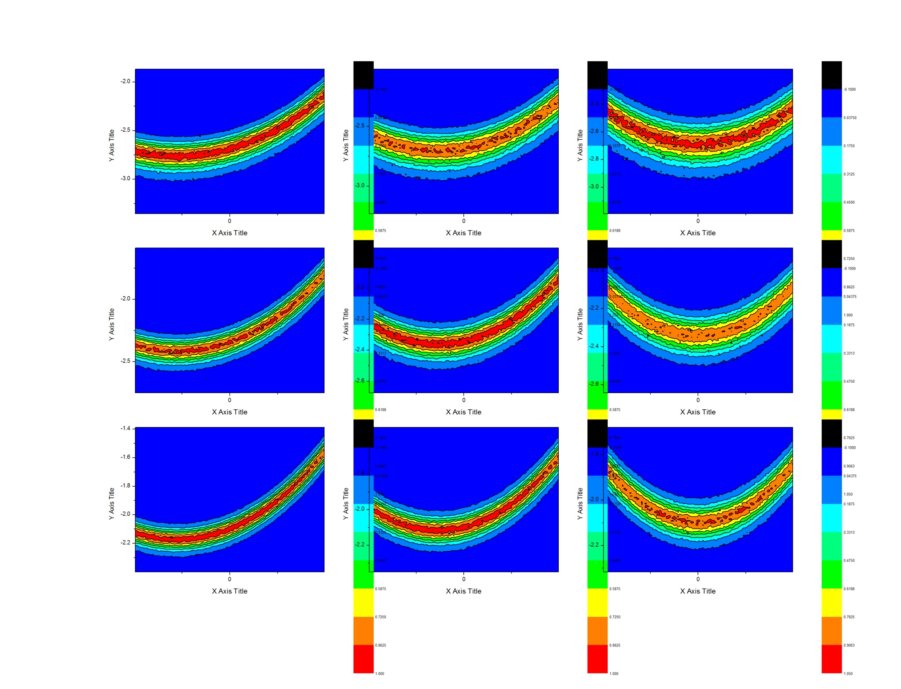
deps-6.5
eta0.3
eta0.4
eta0.5
gam0.5
gam0.75
gam1.0

Slide 4
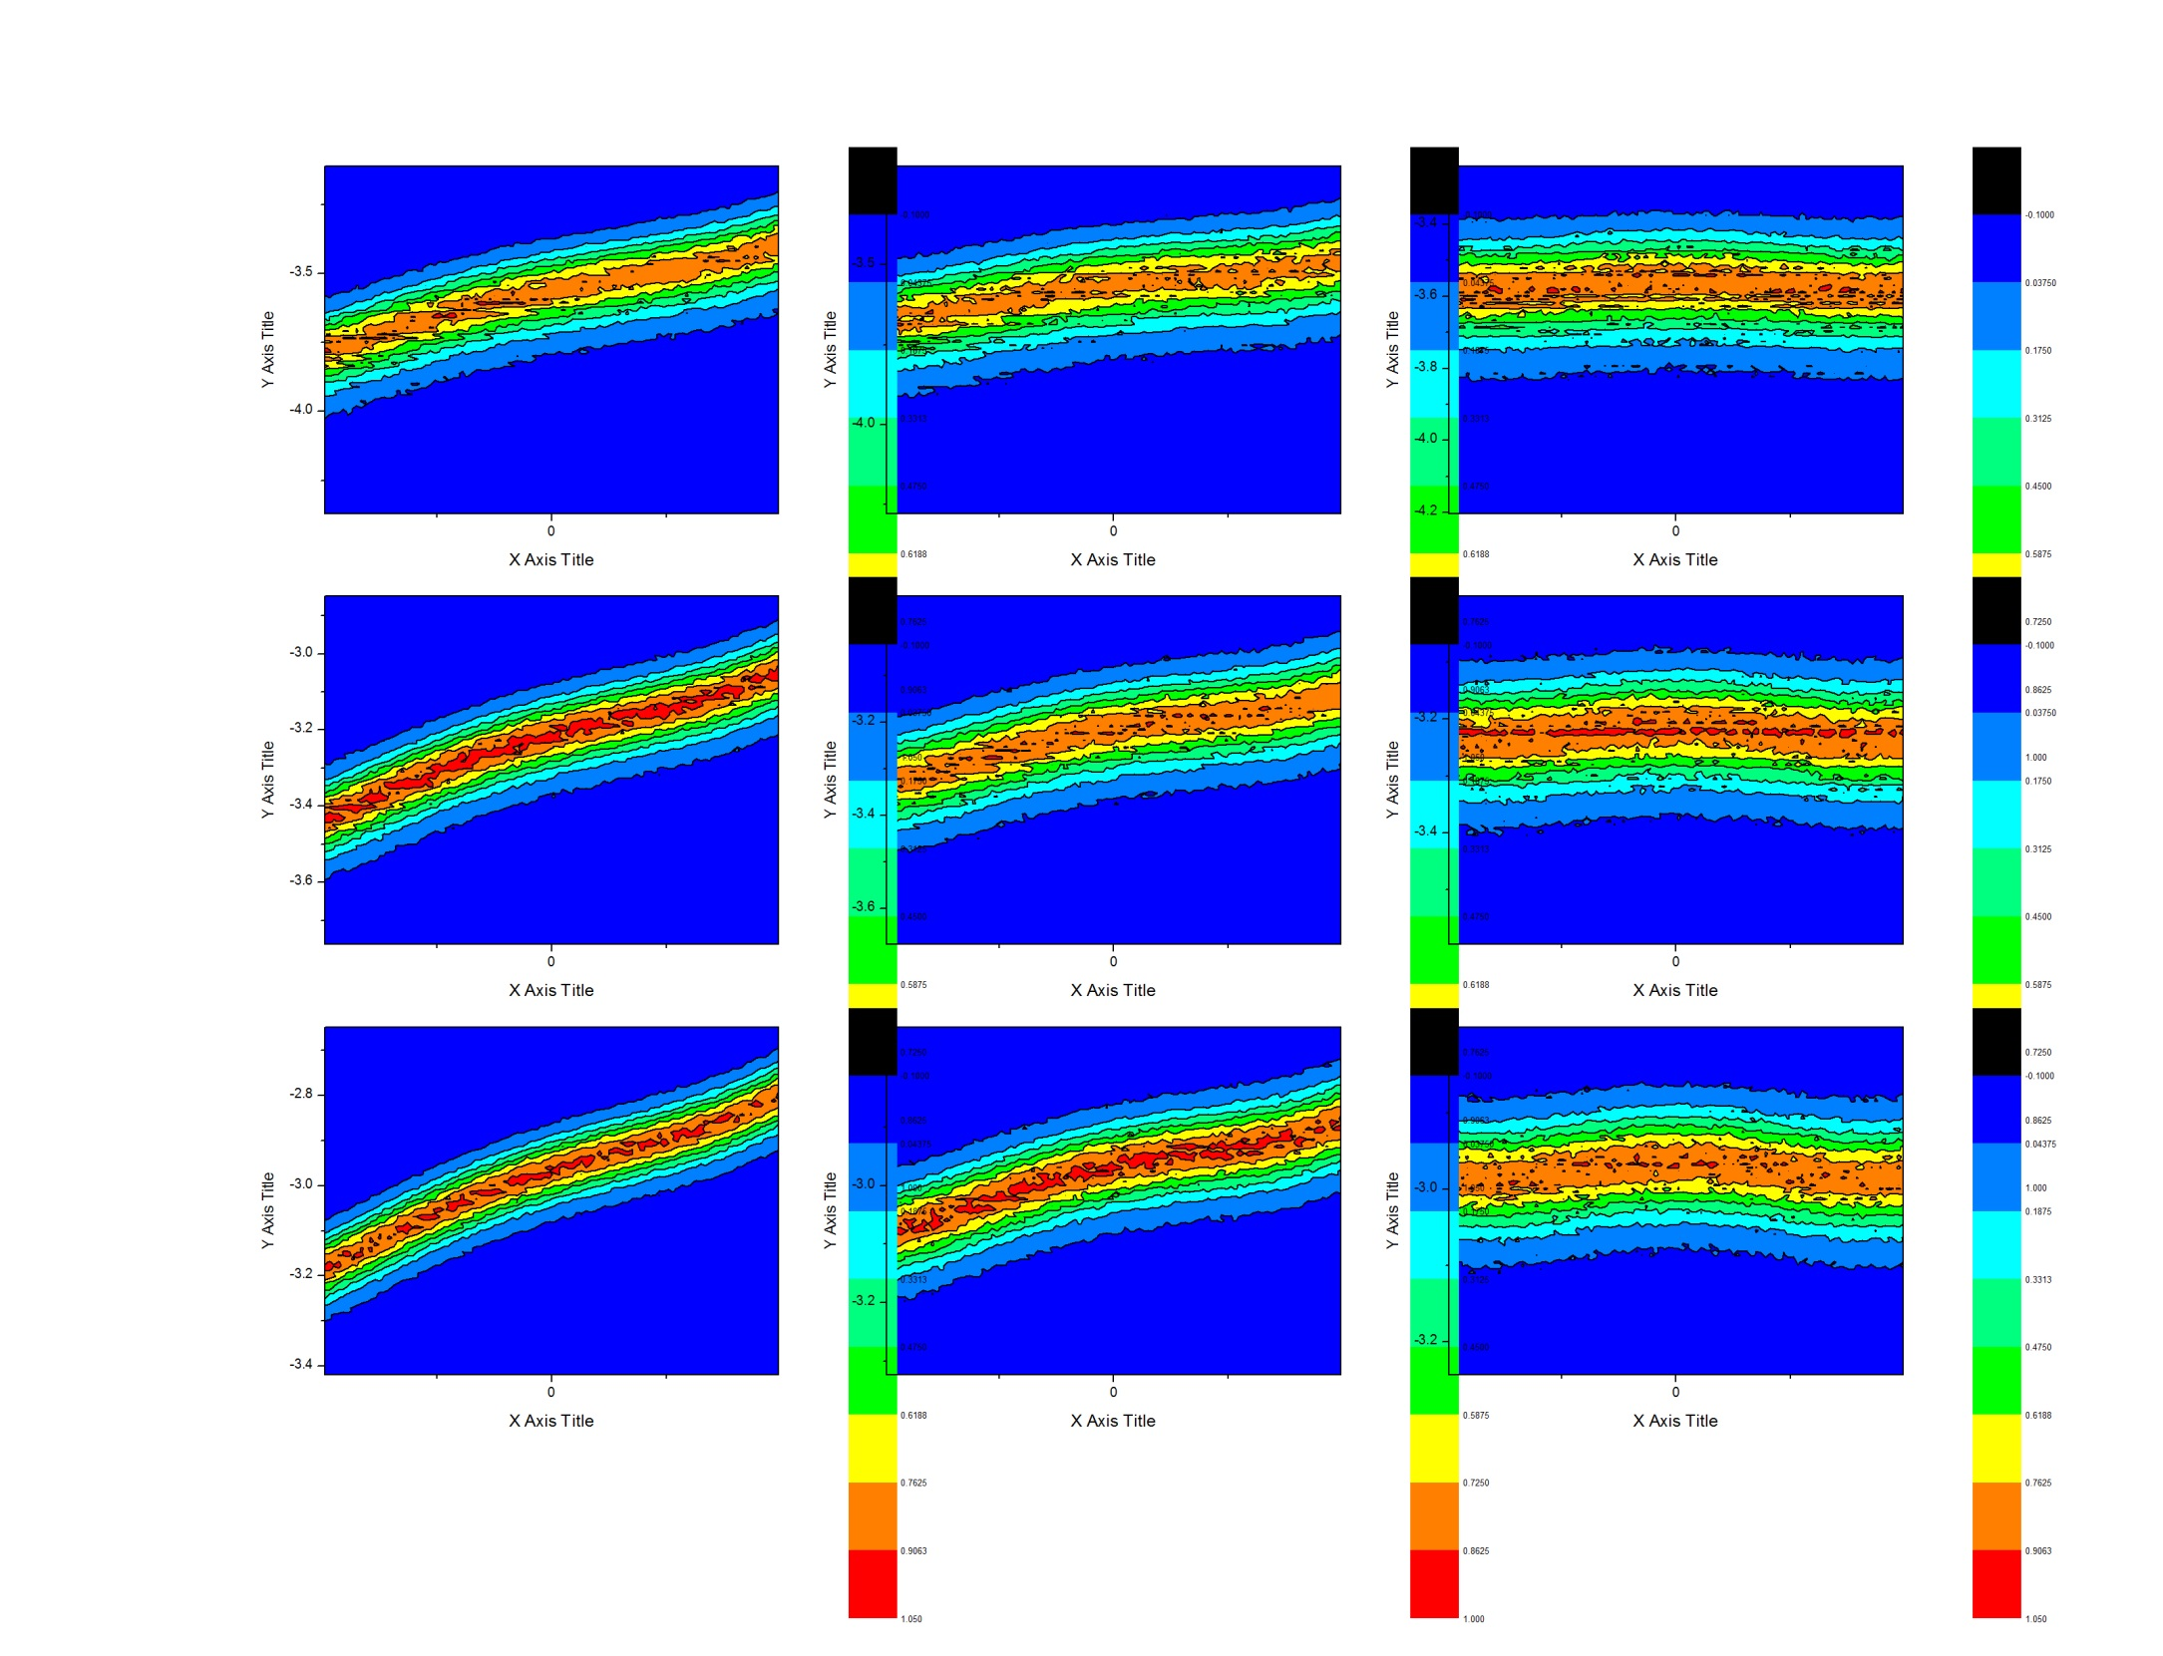
deps-10
eta0.3
eta0.4
eta0.5
gam0.5
gam0.75
gam1.0

Slide 5
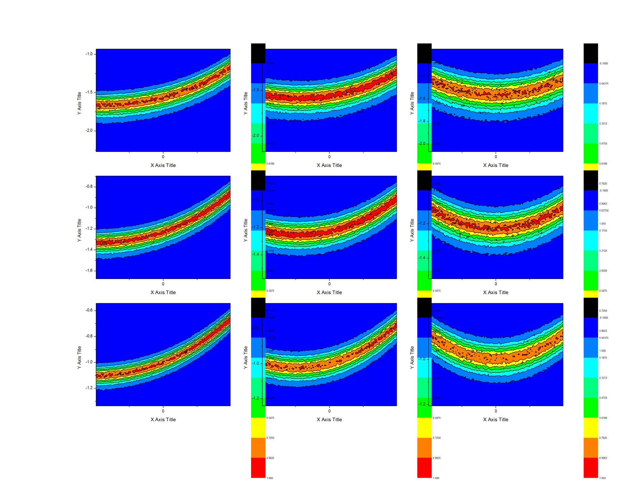
ieps-3
eta0.3
eta0.4
eta0.5
gam0.5
gam0.75
gam1.0

Slide 6
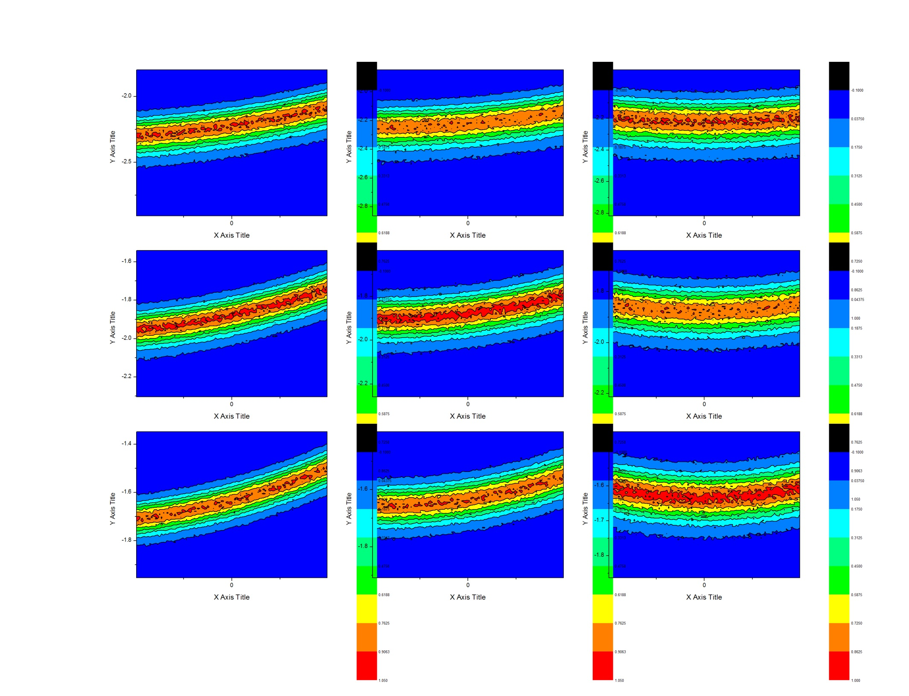
ieps-6.5
eta0.3
eta0.4
eta0.5
gam0.5
gam0.75
gam1.0

Slide 7
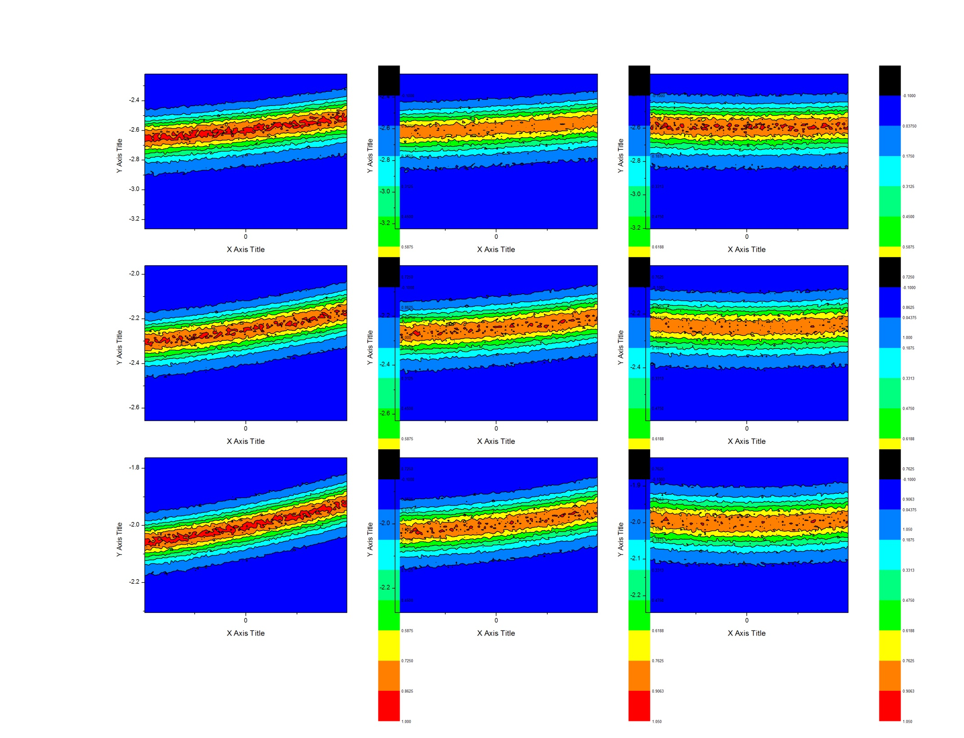
ieps-10
eta0.3
eta0.4
eta0.5
gam0.5
gam0.75
gam1.0

Slide 8

seps-3
eta0.3
eta0.4
eta0.5
gam0.5
gam0.75
gam1.0

Slide 9
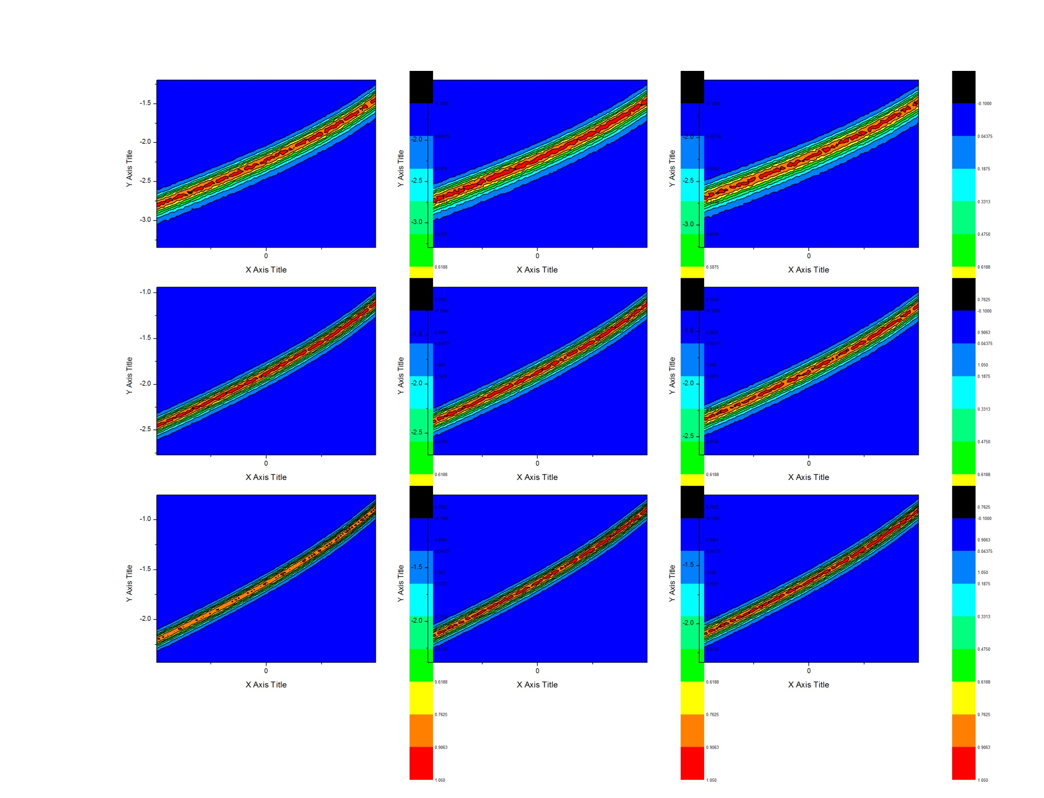
seps-6.5
eta0.3
eta0.4
eta0.5
gam0.5
gam0.75
gam1.0

Slide 10
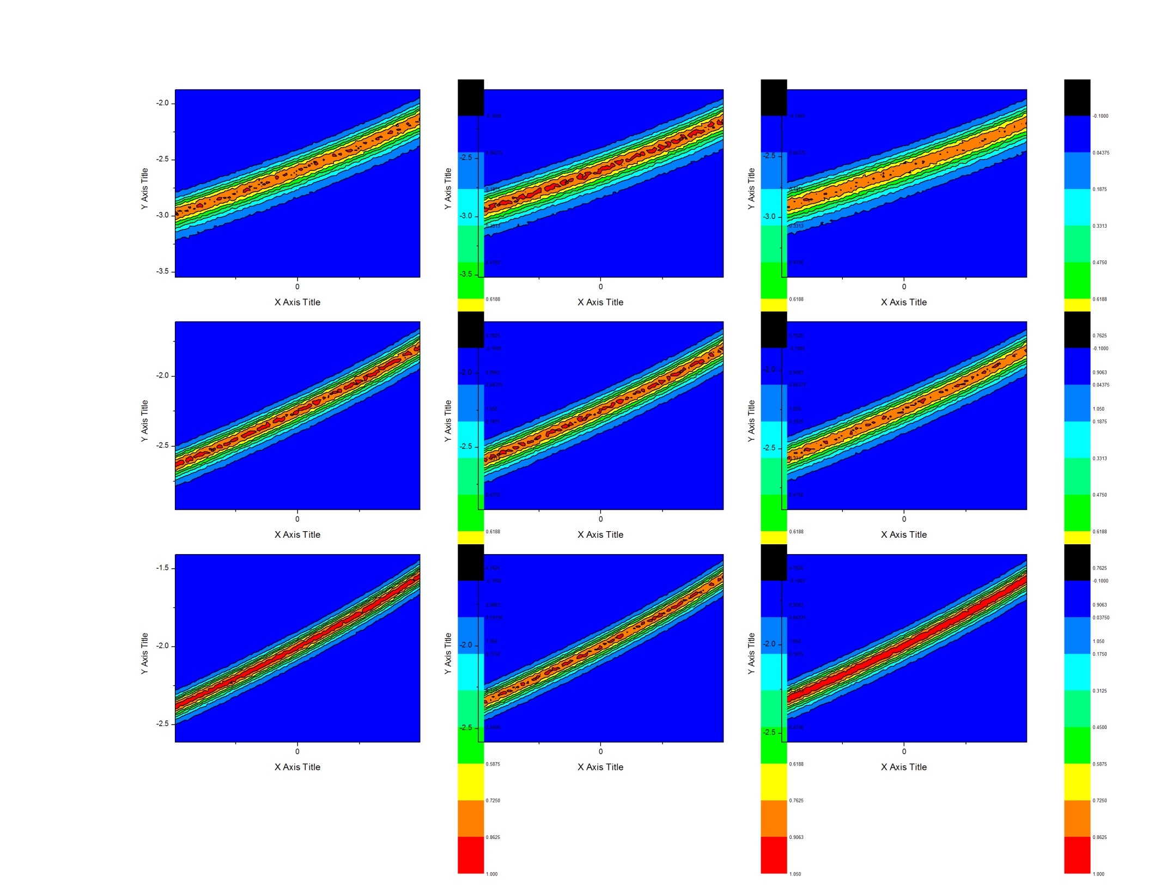
seps-10
eta0.3
eta0.4
eta0.5
gam0.5
gam0.75
gam1.0

